Slide 1
Characterizing Nanocomposites for Customizable Cartilage Replacements
Presenter: Alexis Hocken
PI: Prof Matthew D. Green
School for Engineering of Matter, Transport and Energy
Arizona State University

Slide 2
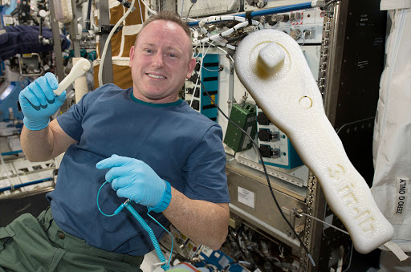
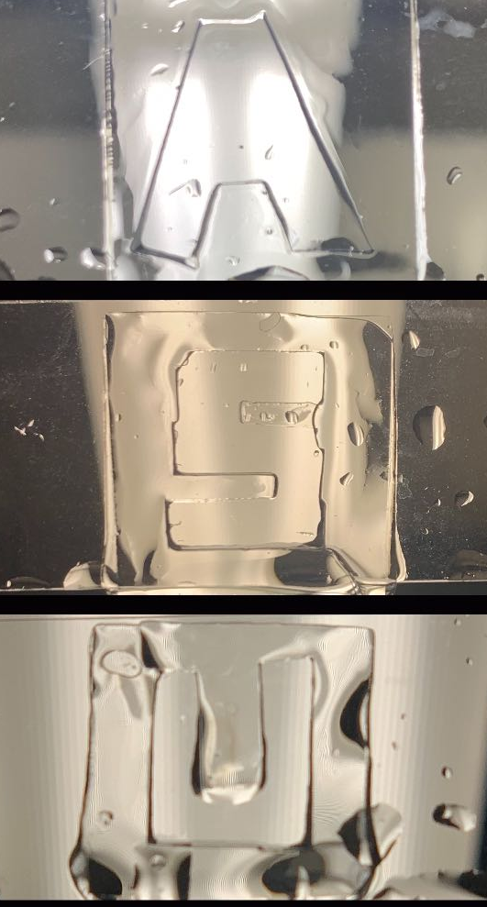

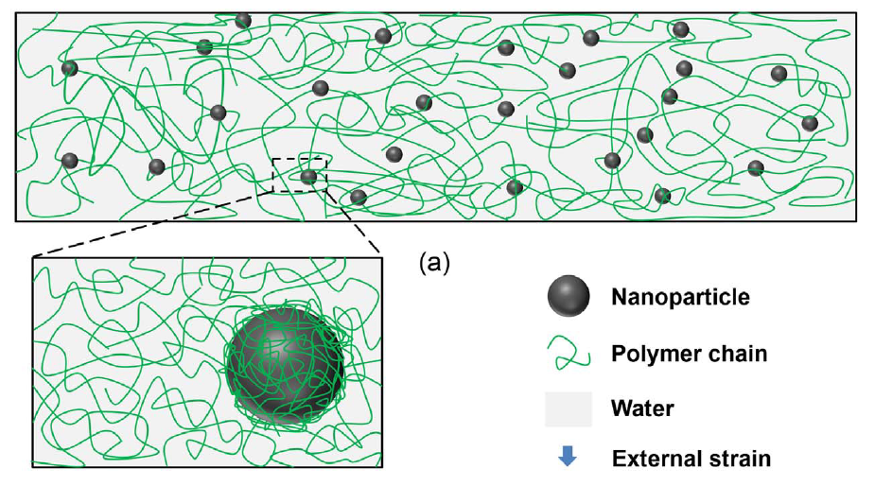

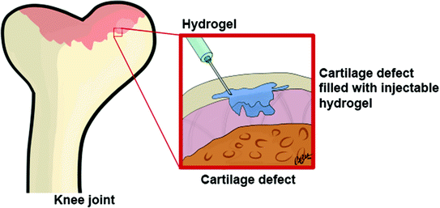
Introduction
1
Nanocomposite applications
  Consumer products
  Construction
  Biomedical applications
Zhan, et al. J. Mech. Behav. Biomed. 2017, 75, 236–243.

Slide 3

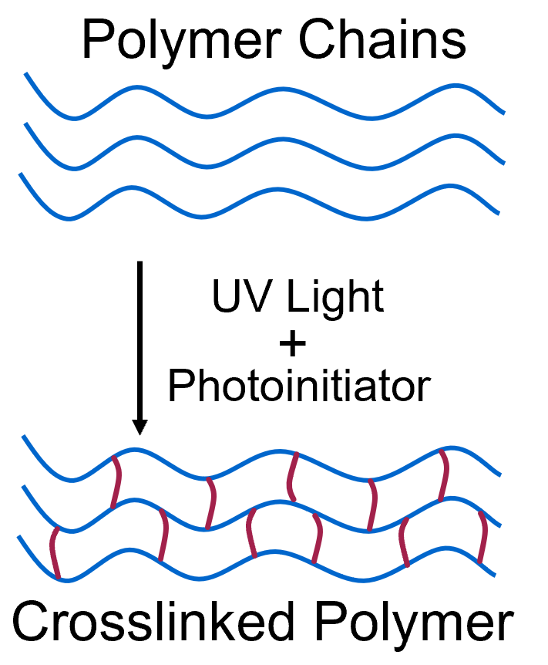
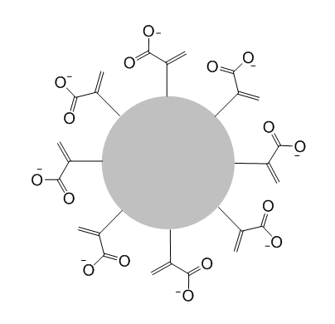

Introduction
2
This study aims to understand the influence of V-SiO₂ and MA-SiO₂ loading on the polymerization yield, morphology, and tensile performance
We analyzed samples with 0, 3.8, 7.4, 10.7, and 13.8 wt% silica nanoparticles
Phase 1:
Photocuring Mechanism
SiO₂
Unfunctionalized SiO₂
Phase 2:
SiO₂
SiO₂
MA-SiO₂
V-SiO₂
Hocken, et al. Industrial & Engineering Chemistry Research. 2019, 58 (32).

Slide 4
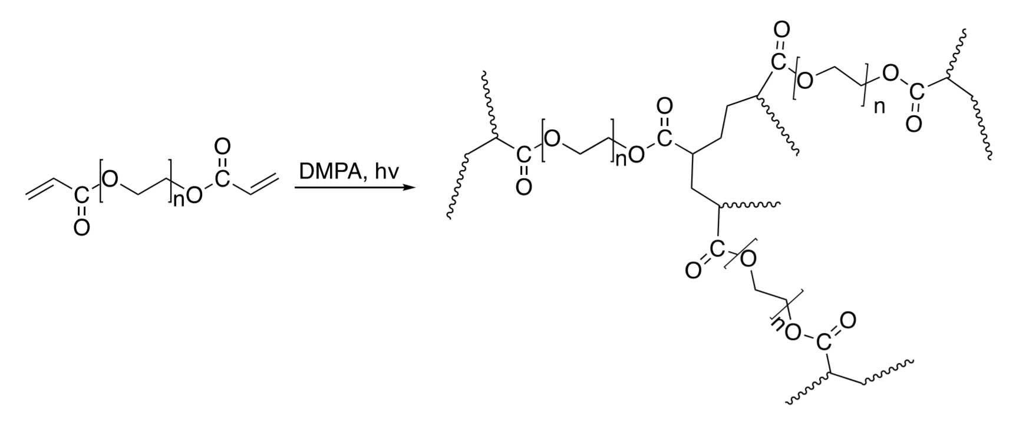
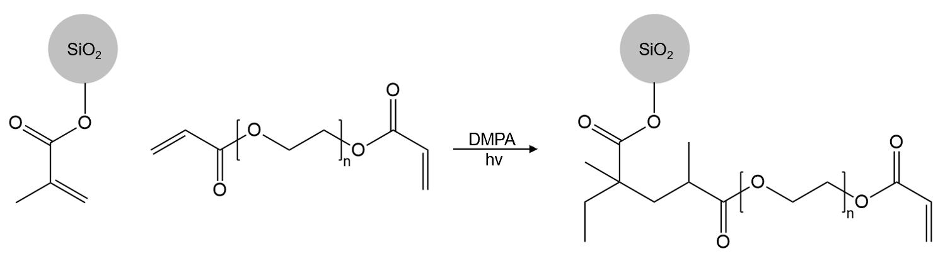
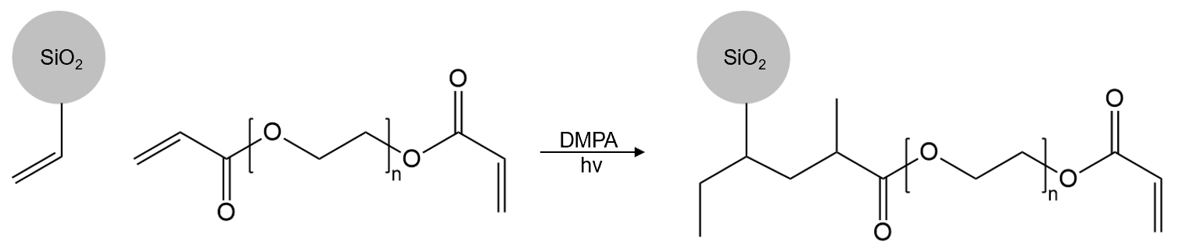
Background
3
Cross-Linking Reaction of PEGDA Initiated by DMPA under UV Light
Cross-Linking Reaction of PEGDA with MA-SiO₂
Cross-Linking Reaction of PEGDA with V-SiO₂
Hocken, et al. Industrial & Engineering Chemistry Research. 2019, 58 (32).

Slide 5
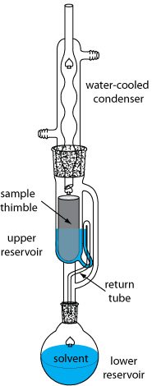
Confirming Gel Fraction
4
SiO₂*
MA-SiO₂
V-SiO₂
SiO₂
SiO₂
MA-SiO₂
V-SiO₂
*Hocken, et al. Industrial & Engineering Chemistry Research. 2019, 58 (32).
Notes:
by scavenging radicals, limiting diffusion, or simply by diluting the concentration of monomer in the system

Slide 6
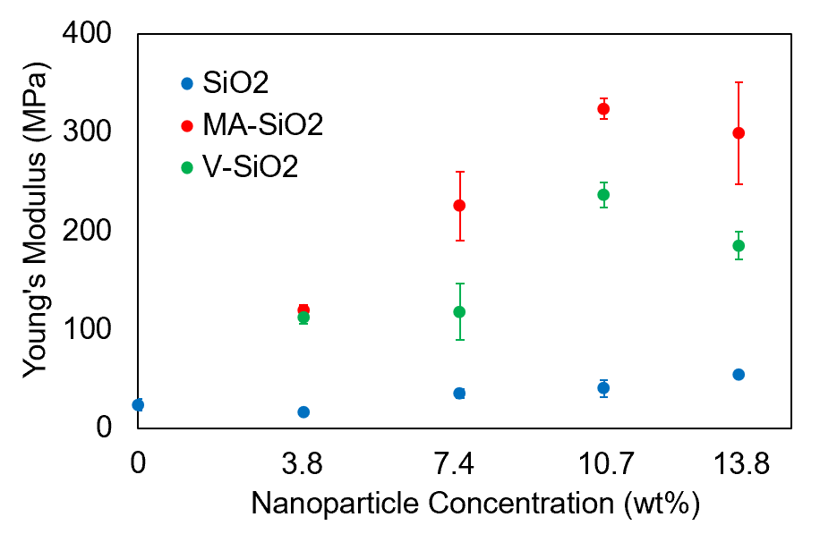
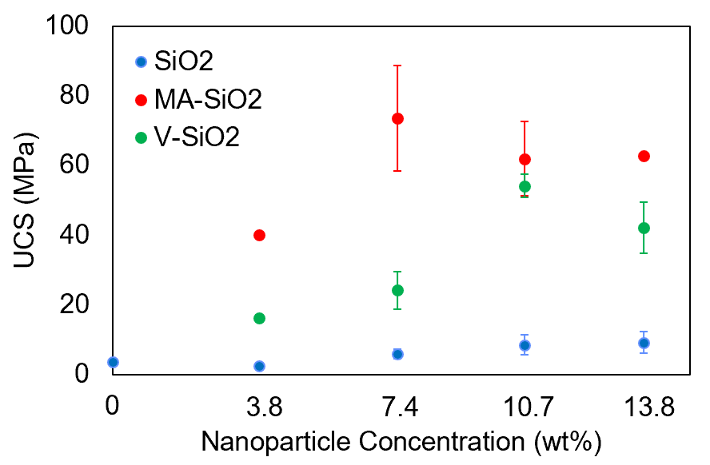
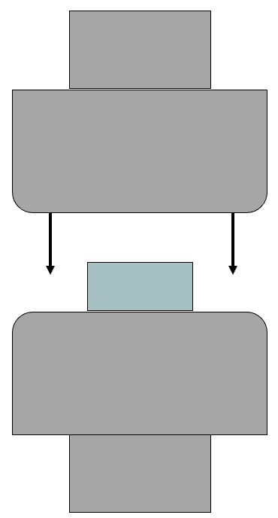
Determining Mechanical Properties
5
SiO₂*
SiO₂*
MA-SiO₂
MA-SiO₂
V-SiO₂
V-SiO₂
SiO₂
SiO₂
MA-SiO₂
V-SiO₂
*Hocken, et al. Industrial & Engineering Chemistry Research. 2019, 58 (32).
Notes:
by scavenging radicals, limiting diffusion, or simply by diluting the concentration of monomer in the system

Slide 7
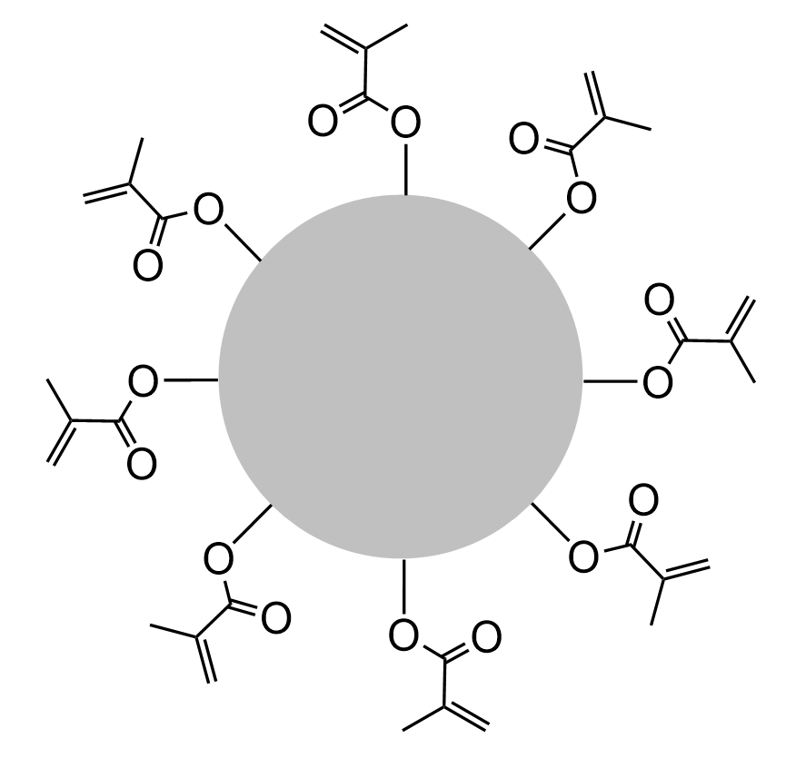
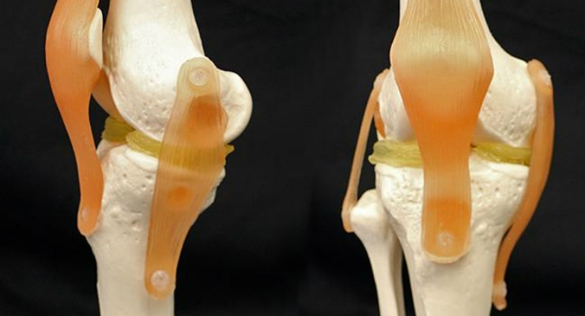
Conclusions & Future Work
6
For this V-SiO₂ and MA-SiO₂ :
  Investigate composite composition through TGA and DMA
  Formalize a manuscript and submit for publication
Moving further, we could investigate the effects of :
  Other nanoscale additives
    Other surface compositions
    Other sizes
  Cross-linker molecular weight
  Photocatalysts
SiO₂
SiO₂
SiO₂

Slide 8






Acknowledgements
7
PI: Dr. Matthew D. Green
ASU/NASA Space Grant Program
Fellow Labmates: Dr. Yi Yang, Dr. Meng Wang, Jason Lee, Mani Korah, Brad Grim, Hoda Shokrollahzadeh
Dr. Frederick L. Beyer and Dr. Brian F. Morgan at the Army Research Lab

